Slide 1

Project Work - II
Department of Computer Science and Engineering
OFF - CAMPUS Internship
from
“ RWS Moravia India Private Limited ”
Submitted To: Submitted By:
Dr. Kailash Bandhu Pragya Sardar
Mr. Binod K Mishra EN18CS301171

Slide 2
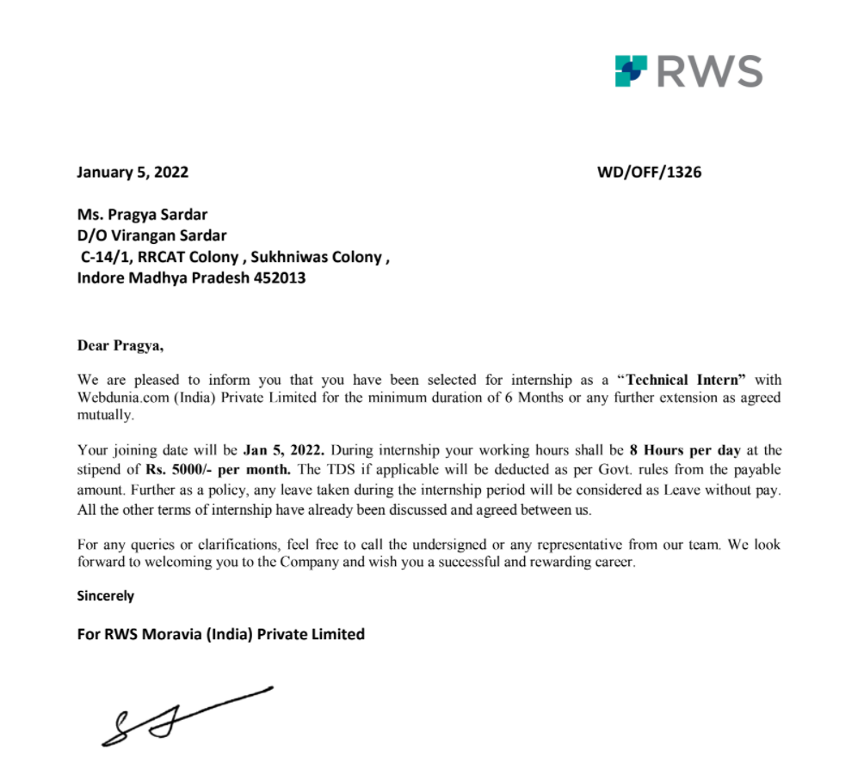
Offer Letter

Slide 3

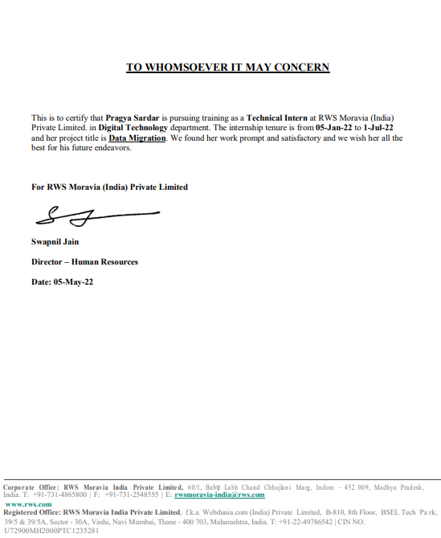
Internship Certificate

Slide 4
Contents
Company Profile
Data Migration
Introduction
Problem Statement
Objective
System Requirements
Algorithms Used
Proposed Work

Slide 5
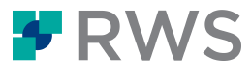
About RWS MORAVIA
RWS Moravia is a leading globalization solutions provider, enabling companies in the IT, consumer electronics, retail, media and entertainment, and travel and hospitality industries to enter global markets with high-quality multilingual products and services.
RWS Moravia’s solutions include localization, testing, content creation, machine translation implementations, technology consulting, and global digital marketing services.
Website : https://www.rws.com/

Slide 6
Data Migration
This project involves majorly data extraction, removing redundancy from customer data and entering them in new system after cleansing for business insights as well as to have accurate customer information across whole organization.

Slide 7
Introduction
A common data quality problem is to have multiple different records that refer to the same entity but no unique identifier that ties these entities together.
For instance, customer data may have been entered multiple times in multiple different computer systems, with different spellings of names, different addresses, and other typos. The lack of a unique customer identifier presents challenges at all stages of data analysis - from basic questions such counting the number of unique customers, to feature engineering of customers’ details for machine learning purposes.
There is a large body of theoretical and empirical work into this problem. The solution usually involves computing a new unique identifier column which allows entities to be linked and grouped, using a process of statistical estimation, machine learning.

Slide 8
Problem Statement
One of the main challenges for the transformation program is to be able to identify, evaluate and process existing Customer Data located in different systems that are also geographically dispersed. The data needs to be identified, quantified, and evaluated for processing. If data is to be transformed this data needs to be extracted, deduplicated and transformed which includes cleansing, matching and merging processes, ready to populate new systems.

Slide 9
Objective
The data needs to be identified, quantified, and evaluated for processing. If data is to be transformed this data needs to be extracted, deduplicated and transformed which includes cleansing, matching and merging processes, ready to populate new systems.
Record Linkage, Entity Resolution or Entity Matching is a crucial step in data cleaning which aims to find records (i.e., database tuples) that refer to the same real-world entity. Record Linkage is an expensive process that could take many hours or even days. The situation become more complicated especially for large datasets as it compares a pair of records using one or more similarity measures.

Slide 10
Algorithms Used
JACCARD SIMILARITY: Jaccard Similarity is used to measures the similarity between two sets of data to see which members are shared and distinct.
JARO – WINKLER: The Jaro - Winkler distance is a string metric measuring an edit distance between two sequences.
The lower the Jaro - Winkler distance for two strings is, the more similar the strings are.
The score is normalized such that 0 means an exact match and 1 means there is no similarity.

Slide 11
Proposed Work
STEP 1: First step in the DATA MIGRATION project is analysis of the data that is received. This data is first categorized as structured or unstructured data and the whole process is first documented.
STEP 2: Once the analysis of the data is completed and validated, we extract the useful and meaningful data by cleaning it, that includes removing the blank spaces, extra commas, hyphens, or fixing duplicate, inappropriate or corrupted data.
STEP 3: After the validation of the whole cleansing process, next step was to map the records that seemed similar. For comparing the different records, we used 2 algorithms: Jaccard Similarity and Jaro - Winkler.

Slide 12
Proposed Work (Cont.)
STEP 4: Next step was to load or migrate the mapped data into the target system for that we then identified which all attributes are necessary for the analysis or deduplication. We created a GLOBAL ENTITY table for that.
STEP 5: Once the data is loaded into the target system it requires two validations:
Technical Validation
Business Validation.
STEP 6: After all these steps the data gets ready for the business insights.

Slide 13
System Requirements
SOFTWARE REQUIREMENTS
Scala IDE
Apache Spark
HARDWARE REQUIREMENTS
RAM – 8.00 GB
Processor – i5 11th Gen Intel Core Processor
Hard Drive Space – 1TB 256 GB SSD

Slide 14


Technologies Used
Scala IDE
Apache Spark

Slide 15
Scala - Scalable Language
Scala combines object-oriented and functional programming in one concise, high-level language.
Scala has been created by Martin Odersky and he released the first version in 2003.
Scala's static types help avoid bugs in complex applications, and its JVM and JavaScript runtimes let you build high-performance systems with easy access to huge ecosystems of libraries.
FEATURES
Object Oriented Language
Statically Typed
Run on JVM
Functional

Slide 16
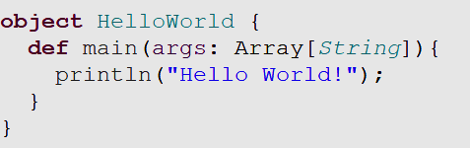

Scala Code
Scala Program Example
Compile and execute the Scala program
OUTPUT

Slide 17
Apache Spark
Apache Spark is an open-source, distributed processing system used for big data workloads.
It provides development APIs in Java, Scala, Python and R, and supports code reuse across multiple workloads—batch processing, interactive queries, real-time analytics, machine learning, and graph processing.
FEATURES:
Fast Processing
Flexibility
In-memory computation
Real Time Processing
Fault Tolerance in Spark
Advance Analytics

Slide 18
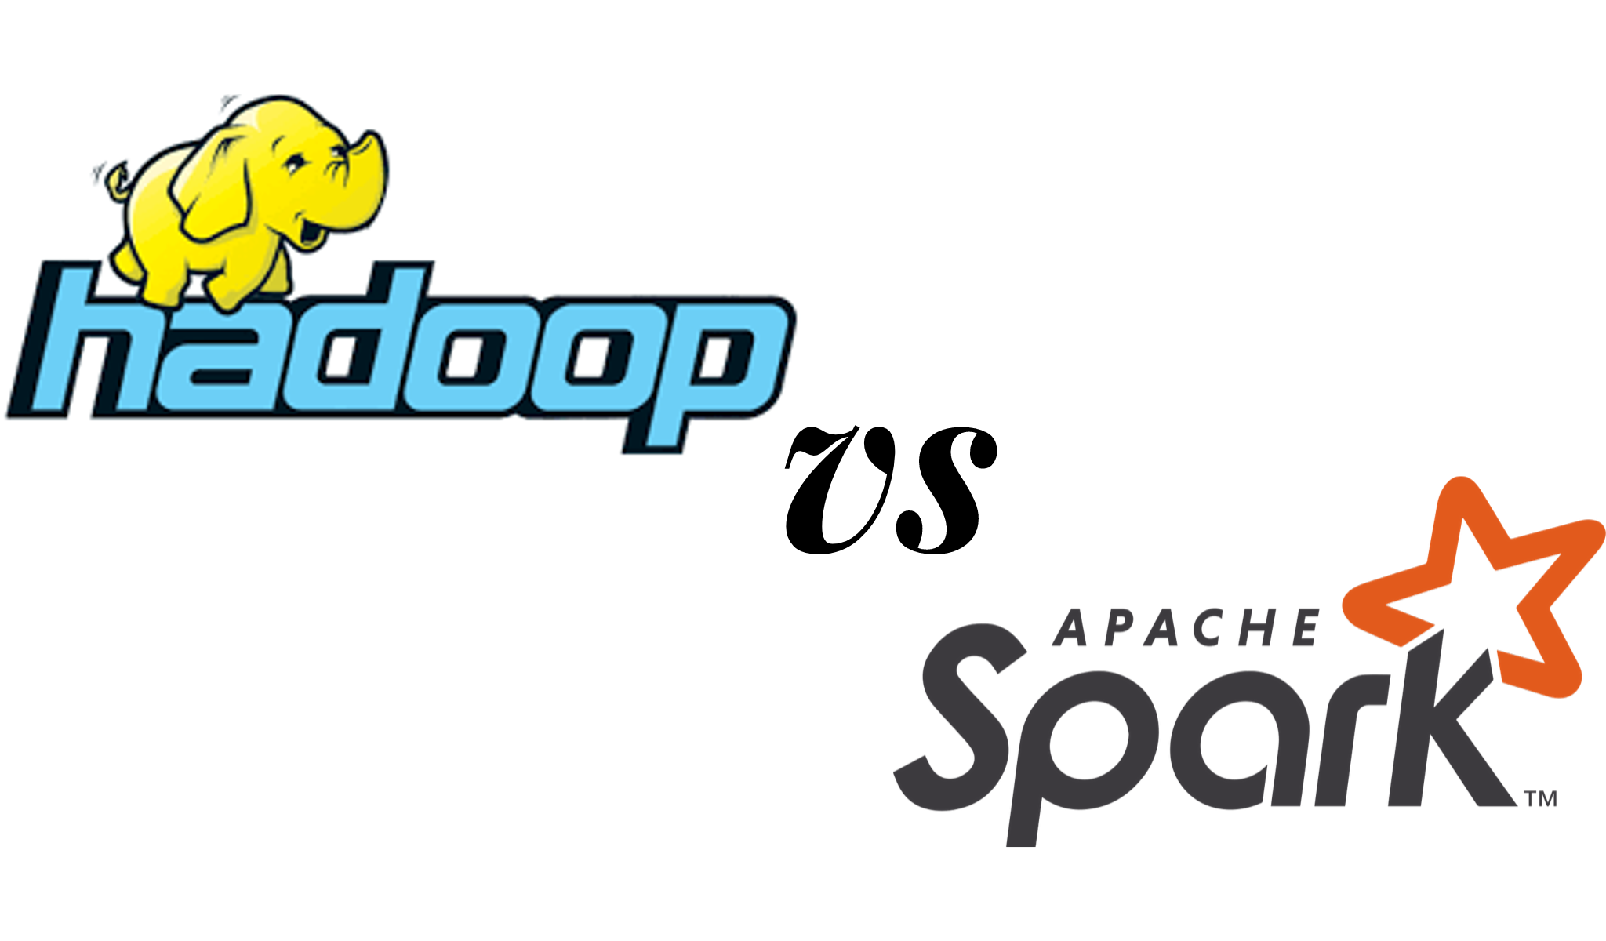
Apache Spark VS Apache Hadoop
Performance
Cost
Processing
Scalability
Security
Machine learning (ML)

Slide 19
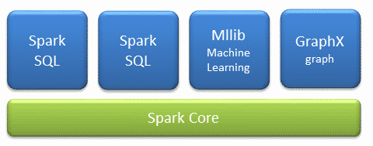
Apache Spark Components
The Spark project consists of different types of tightly integrated components. At its core, Spark is a computational engine that can schedule, distribute and monitor multiple applications.

Slide 20
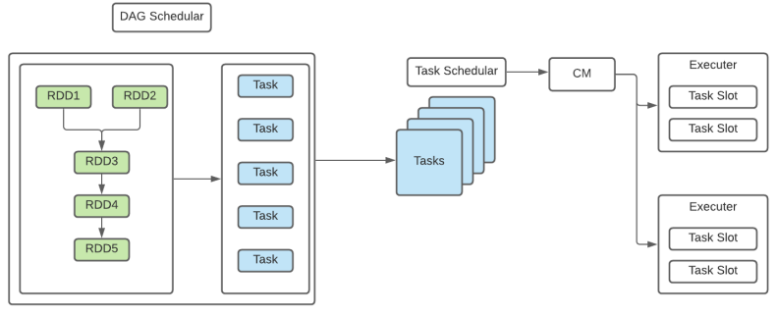
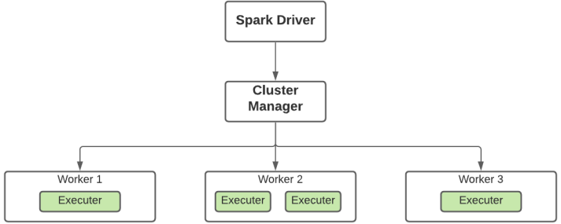
Apache Spark Architecture

Slide 21
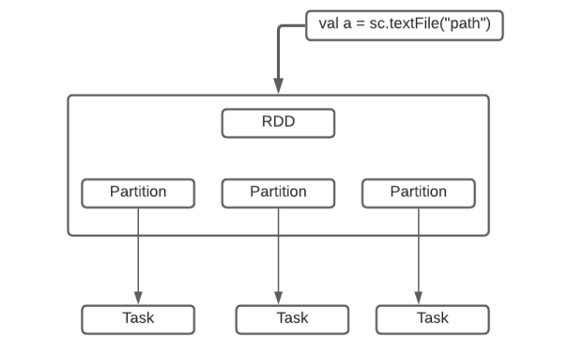
Spark RDD - Resilient Distributed Dataset
Resilient Distributed Datasets (RDD) is a fundamental data structure of Spark.
It is an immutable distributed collection of objects. Each RDD is divided into logical partitions, which may be computed on different nodes of the cluster.
FEATURES:
Immutable
Performs Lazy Evaluation
In-memory computation
Real Time Processing
Fault Tolerance in Spark

Slide 22
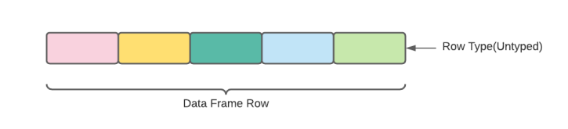
Apache Spark Data Frames
A Data Frame is a distributed collection of data, which is organized into named columns.
Conceptually, it is equivalent to relational tables with good optimization techniques. A Data Frame can be constructed from an array of different sources such as Hive tables, Structured Data files, external databases, or existing RDDs.
This API was designed for modern Big Data and data science applications taking inspiration from Data Frame in R Programming and Pandas in Python

Slide 23
Apache Spark Data Frames
FEATURES:
Use of Input Optimization Engine
Handling of Structured Data
Custom Memory Management
Flexibility
Scalability

Slide 24
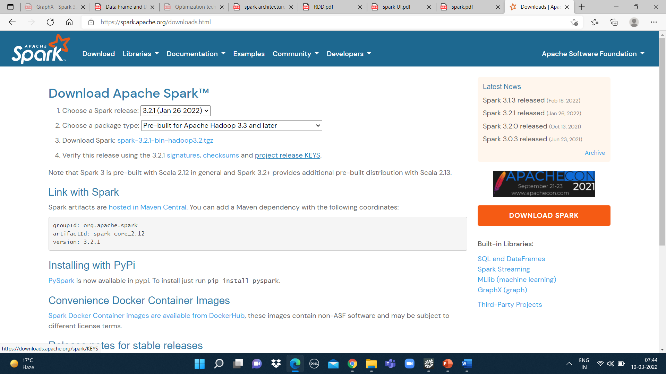
Spark Installation

Slide 25
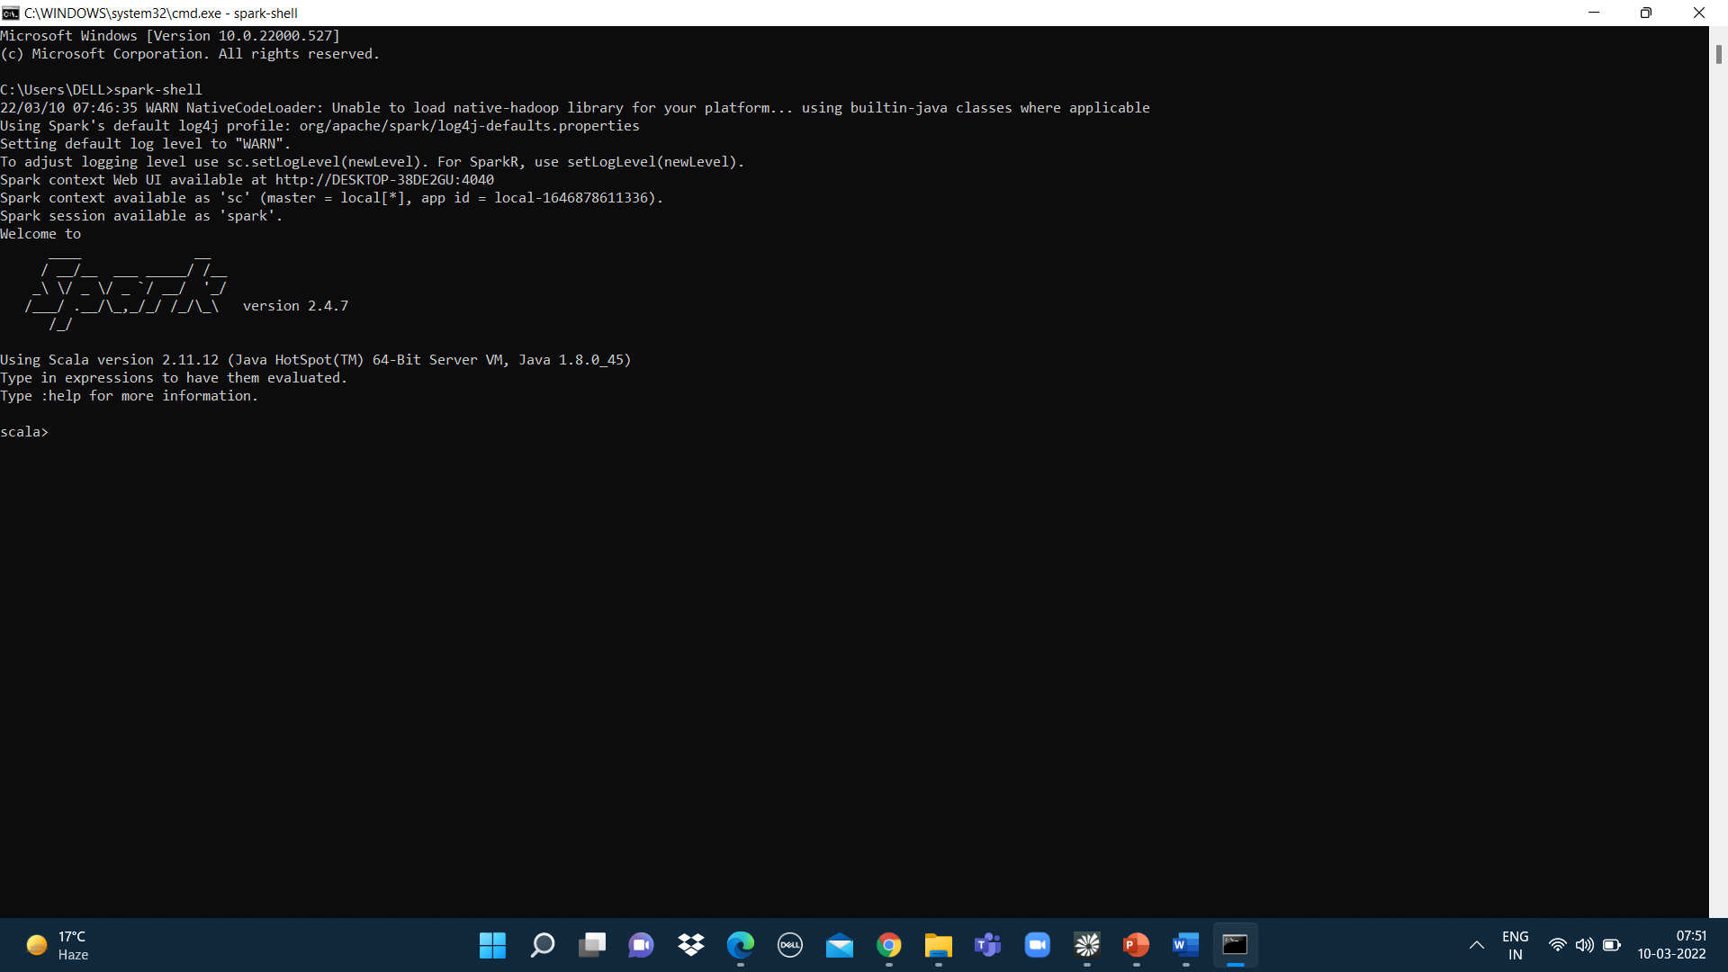

Slide 26
Thank You!

